Slide 1
Data Wrangling Operations using R
Revendranath T
Dept. of Management
BITS Pilani

Slide 2
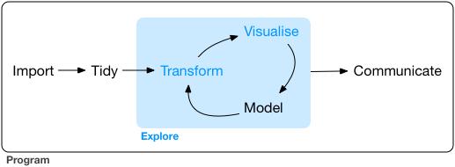
Tidyverse

Slide 3
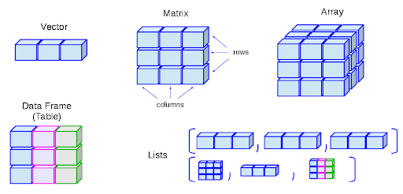
Data Structures

Slide 4


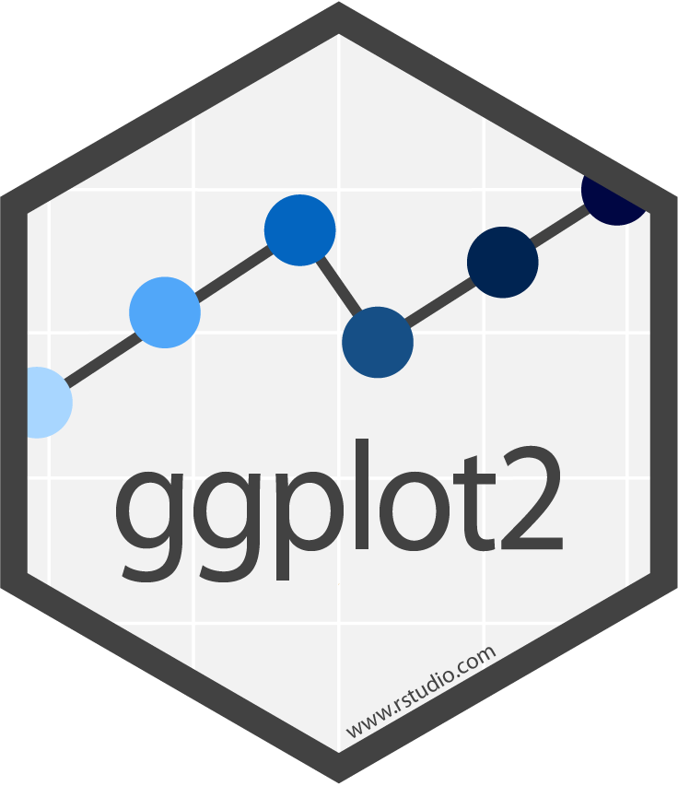

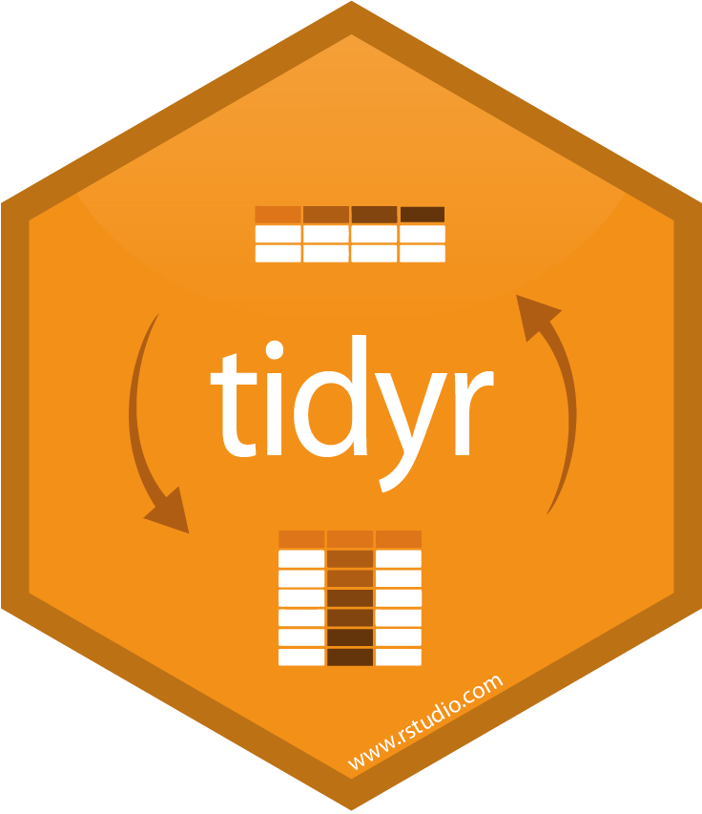

Data Wrangling in R
library(tidyverse)

Slide 5
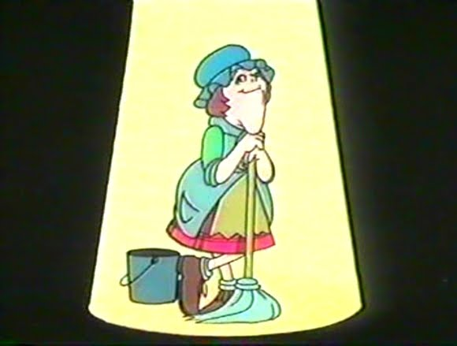
For Big-Data Scientists, ‘Janitor Work’ Is Key Hurdle to Insights
nytimes.com/2014/08/18/technology/for-big-data-scientists-hurdle-to-insights-is-janitor-work.html
“Data scientists, according to interviews and expert estimates, spend from 50 to 80 percent of their time mired in the mundane labor of collecting and preparing data, before it can be explored for useful information.” –– NY Times (2014)

Slide 6
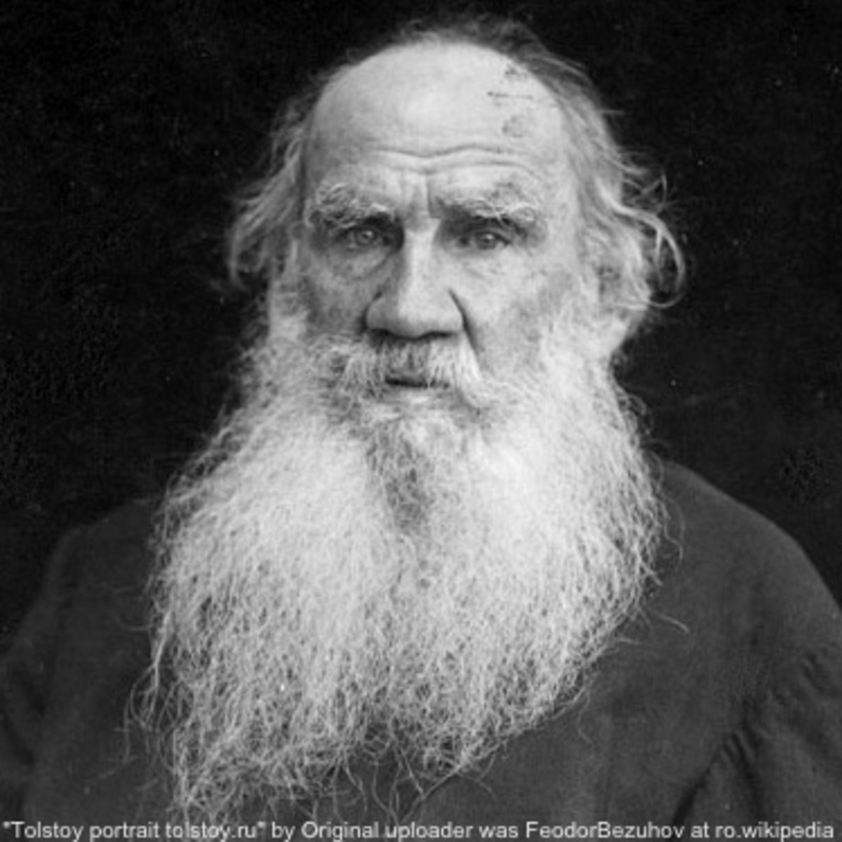

“Happy families are all alike; every unhappy family is unhappy in its own way.” –– Leo Tolstoy
“Tidy datasets are all alike, but every messy dataset is messy in its own way.” –– Hadley Wickham

Slide 7
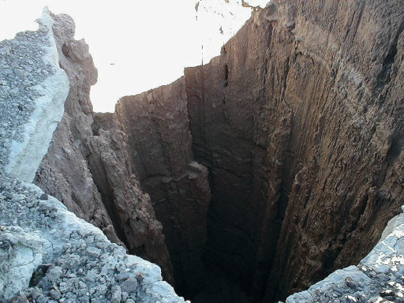


Tidy Manifesto
Reuse existing data structures
Compose simple functions with the pipe
Embrace functional programming
Design for humans
Fall into the Pit of Success
cran.r-project.org/web/packages/tidyverse/vignettes/manifesto.html
”
blog.codinghorror.com/falling-into-the-pit-of-success

Slide 8

Tidyverse process
& packages (unofficial in italics)
Program
Visualize
Import
static: ggplot2
ggraph ggmap
interactive: plotly leaflet
dygraphs
readr readxl
DBI jsonlite googledrive
purrr
fs
devtools
usethis
spatial: rgdal sf
raster
Tidy
Transform
Model
tibble
dplyr
tidyr
dplyr lubridate stringr
caret broom
modelr
Communicate
rmarkdown
flexdashboard bookdown

Slide 9

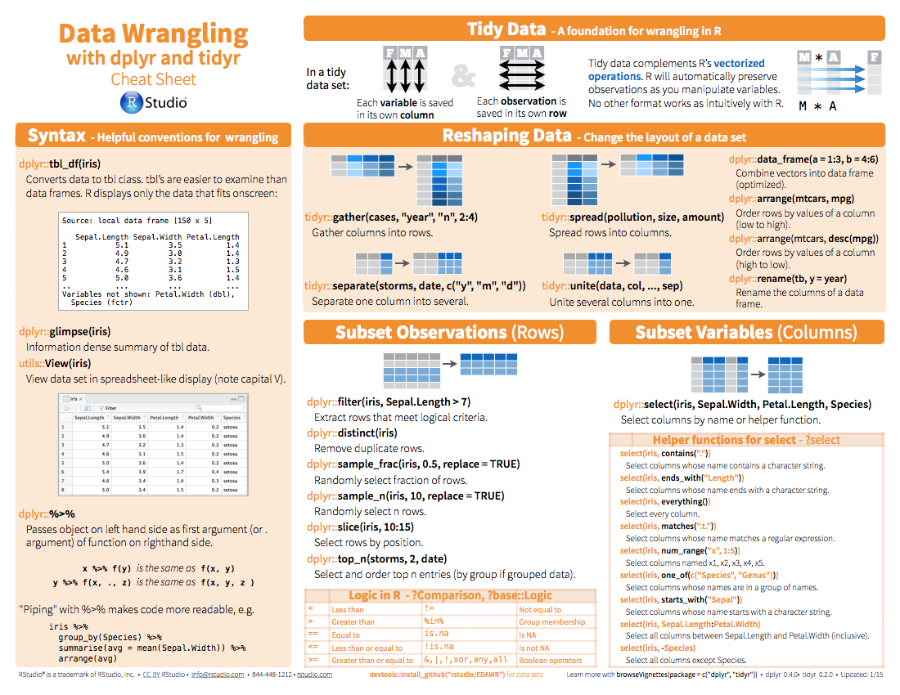
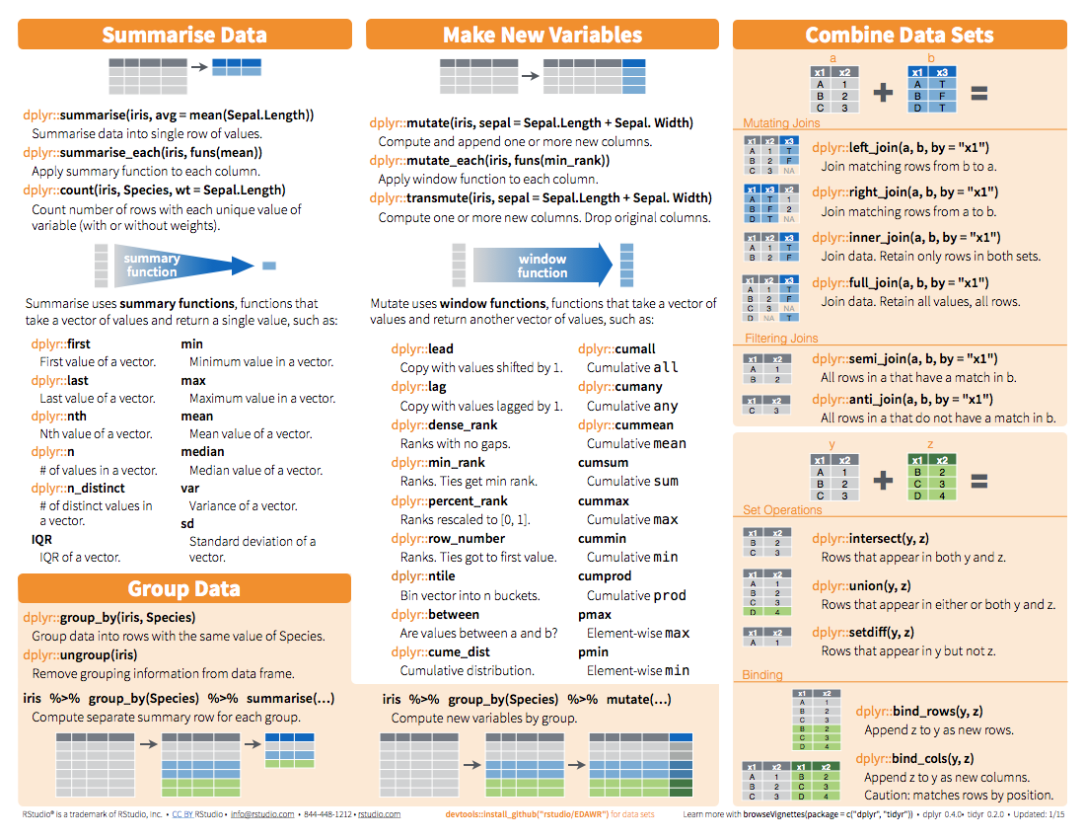
Cheatsheets are
RStudio: Help > Cheatsheets > Data wrangling with dplyr

